Slide 1
Rate Prediction Project
Submitted by,
Poovarasi Vijayan

Slide 2
Content:
Introduction
Problem Statement
Insights of the project
Analytical Problem Facing
EDA
Visualizations
Data Pre Processing and Feature Engineering
Model Development and Evaluation
Conclusion

Slide 3
Introduction:
In today’s web-based world, virtually everyone is reading online reviews. In fact, 91% of people read them and 84% trust as much as they would a personal recommendation. The effects of reviews are measurable, too. Negative reviews can carry as much weight as positive ones. One study found that 82% of those who read online reviews specifically seek out negative reviews.
That may be sound alarming – this states that only emphasizes that negative reviews aren’t going unnoticed – but there are sone benefits: Research indicates that users spend five times as long on sites when interacting with negative reviews, with an 85% increase in conversion rate.
Customers like to see lots of reviews. A single review with few positive words makes up an opinion, but a few dozen that say the same thing make a consensus.
The more reviews, the better, and one study found that consumers want to see at least 40 reviews to justify trusting an average star rating. However, a few reviews are still better than no reviews.
With the vast array of review sites and the level of trust most consumers have in reviews, it’s a safe assumption that virtually everyone considering your products, no matter your target demographic, industry, or market, is reading online reviews before making a purchase.

Slide 4
Problem Statement:
A website has a forum for writing technical reviews of products and consists of repository of reviews for technical products. Now they are adding a new feature to their website i.e. The reviewer will have to add stars(rating) as well with the review. The rating is out 5 stars and it only has 5 options available 1 star, 2 stars, 3 stars, 4 stars, 5 stars. Now they want to predict ratings for the reviews which were written in the past and they don’t have a rating. An application to predict the rating by seeing the review is required to be built. Therefore, a predictive model to accurately predict a user’s rating based on input review is required to be made.

Slide 5
Business Goal:
Ratings are an important metric in e-commerce application to determine a product’s quality, consumer demand, worth and profitability. The sentiment of a user towards a product is reflected in their rating score and their review of the product. This helps determine how the product is perceived by the consumers and in turn gives an idea about the acceptance of the product by the consumers. There is a strong positive correlation between the rating of a product and its consumer demand. Therefore, it is necessary to build a predictive model which can, with good accuracy predict what rating a user might give a particular product based on the user review. This helps understand user sentiment towards a product and determine the product’s worth and acceptance by consumers.

Slide 6
Insights of Project:
As per the requirement of our client, data is scraped from www.flipkart.com, which is one of the e-commerce platforms. This project was built with a aim of gaining insights about reviews and rating which affect the sell of the product. This project is more about data exploration, feature engineering and pre-processing of data.
The goal of this project is to build an application which can predict the ratings of products which can help people buy the products, with the help of the features available. In long term this would allow people to better explain and review their purchase in this digital world.

Slide 7
Analytical Problem Facing:
Analytic problem framing involves translating the business problem into terms that can be addressed analytically via data and modeling. Analytic problem framing is the antithesis of merely working with the ready-to-hand data and seeing what comes of it, hoping for something insightful.

Slide 8
Exploratory data analysis
In Rate prediction problem data is scrapped using webscraping selenium from www.flipkart.com website.
First, the analysis is started with importing the data, this dataset is checked for Null values and unnecessary columns, which does not contribute for the target variable is also dropped.
Once data is cleaned and pre-processed then model evaluation is made based on which rate is predicted.

Slide 9
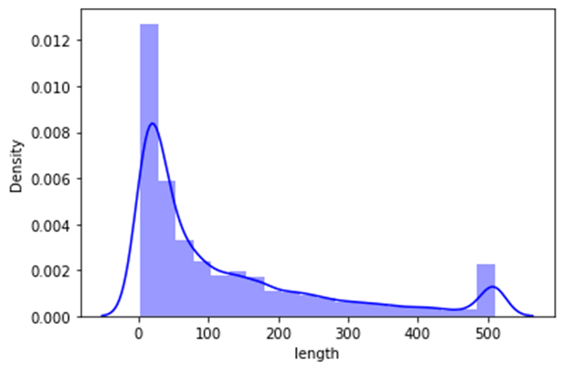
Visualization:
Many words lies between 10-100 and mostly all words are within 500.

Slide 10


Cont.
Reviews corresponding to 5.0 rating frequently carry words like: ‘good’, ’excellent’, ’quality’, ‘value money’ etc indicating very high customer satisfaction and high quality product.
Reviews corresponding to 4.0 rating frequently carry words like: ‘good’, ’great’, ’performance’, ’features’, ‘quality’, ’price’ etc indicating high customer satisfaction and good quality product.

Slide 11
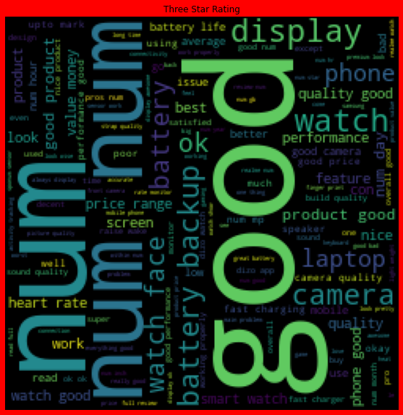
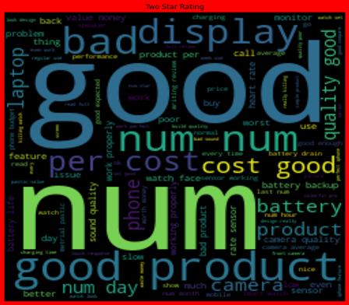
Cont:
Reviews corresponding to 3.0 rating frequently carry words like: ‘good’, ’well’, ’average, ’quality’, ’issue’ etc indicating customer dissatisfaction and average to below average product quality.
Reviews corresponding to 2.0 rating frequently carry words like: ‘problem’, ‘bad’, ’issues’, ’waste money’, ’poor quality’ etc indicating high customer dissatisfaction and below average product quality.

Slide 12

Cont.
Reviews corresponding to 1.0 rating frequently carry words like: ‘stopped’, ’working’, ’cheap’, ’return’, ’issue’, ’waste money’, ’poor quality’,’ customer care’, ’bad’, ‘poor build quality’ etc indicate very high customer dissatisfaction and poor quality product.

Slide 13
Data Pre-Processing and Feature Engineering:
In Machine Learning, data pre-processing refers to the process of cleaning and organising raw data in order to make it appropriate for creating and training Machine Learning models.
In other words, anytime data is received from various sources, it is collected in raw format, which makes analysis impossible. Data pre-processing is a crucial stage in Machine Learning since the quality of data and the relevant information that can be cleaned from it has a direct impact on our model's capacity to learn; consequently, we must pre-process our data before feeding it into our model.
As a result, it is the first and most important stage in developing a machine learning model. Some of the techniques used in this project are listed below:
Started with importing the required libraries and then the train dataset which is in excel.
As the dataset contains 2 variables. Then the information of the columns are observed carefully.

Slide 14
Model Development and Evaluation
The approaches followed in this project are
Find the best random state of a model.
Use all the other models to find accuracy score and AUC ROC values is found.
Then find Cross Validation of all models to find the best accuracy, which is the least difference between r2 score and cv score.
With the best model accuracy, we need to do hyper tuning using GridSearchCV.
Then finally saving the best model and by keeping this we need to predict the Ratings of dataset.

Slide 15
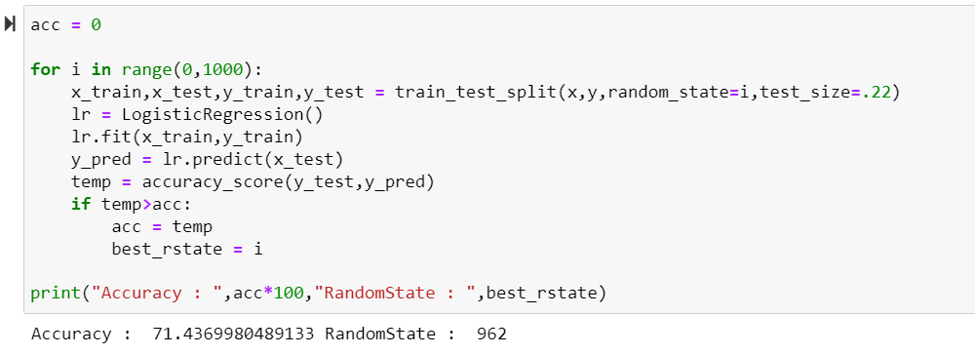
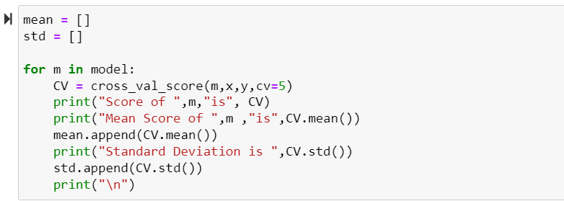
Here accuracy score , cv is checked for all models and final model is selected.

Slide 16
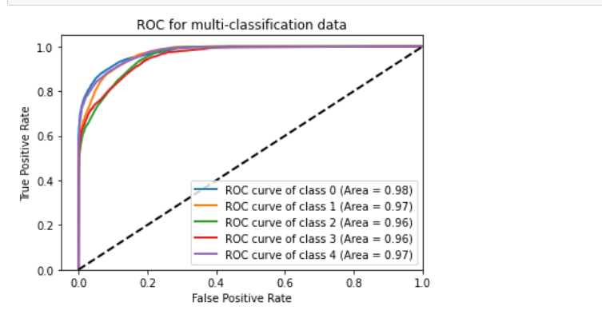
AUC ROC Curve

Slide 17
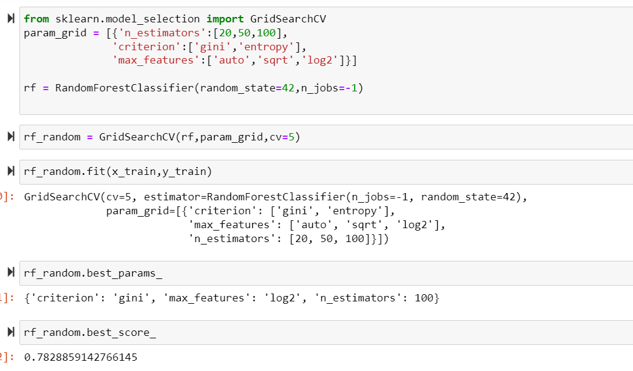
HyperTuning:
Hypertuning is done to improve model accuracy for RandomForestRegressor. By which we improved our accuracy to 78 percent.

Slide 18
Conclusion:
In this project data is collected for reviews and ratings for different products from www.flipkart.com. Then the Ratings is detected from commercial websites on a scale of 1 to 5 on the basis of the reviews given by the users. By using of natural language processing and machine learning algorithms the problem is solved. Then checked frequently occurring words in our data as well as rarely occurring words. After all these steps built function is used to train and test different algorithms and using various evaluation metrics I have selected Random Forest Classifier for our final model. Finally, by doing hyperparameter tuning we got optimum parameters for the final model.
Rating is predicted finally using the best model.

